Slide 1
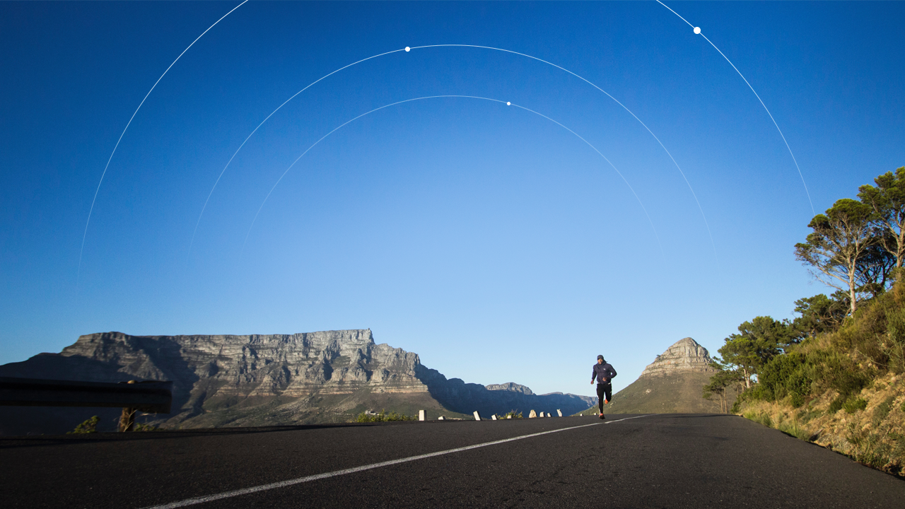

Health App.

Slide 2
50% of Portuguese people are sedentary
24% lacks motivation for physical activities
30% of deaths are caused by cardiovascular diseases
9.8% of adults have diabetes

Slide 3
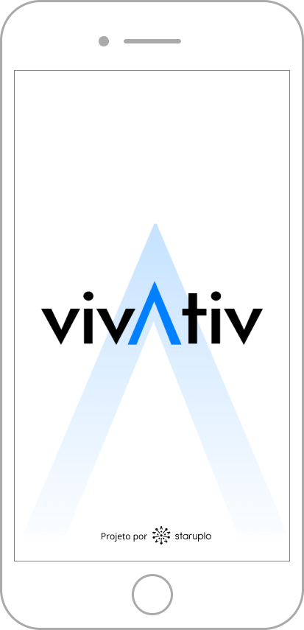
How do we tackle this problem?
Our Algorithm
Slope
Presence of green spaces
Solar Radiation
Air Quality

Slide 4
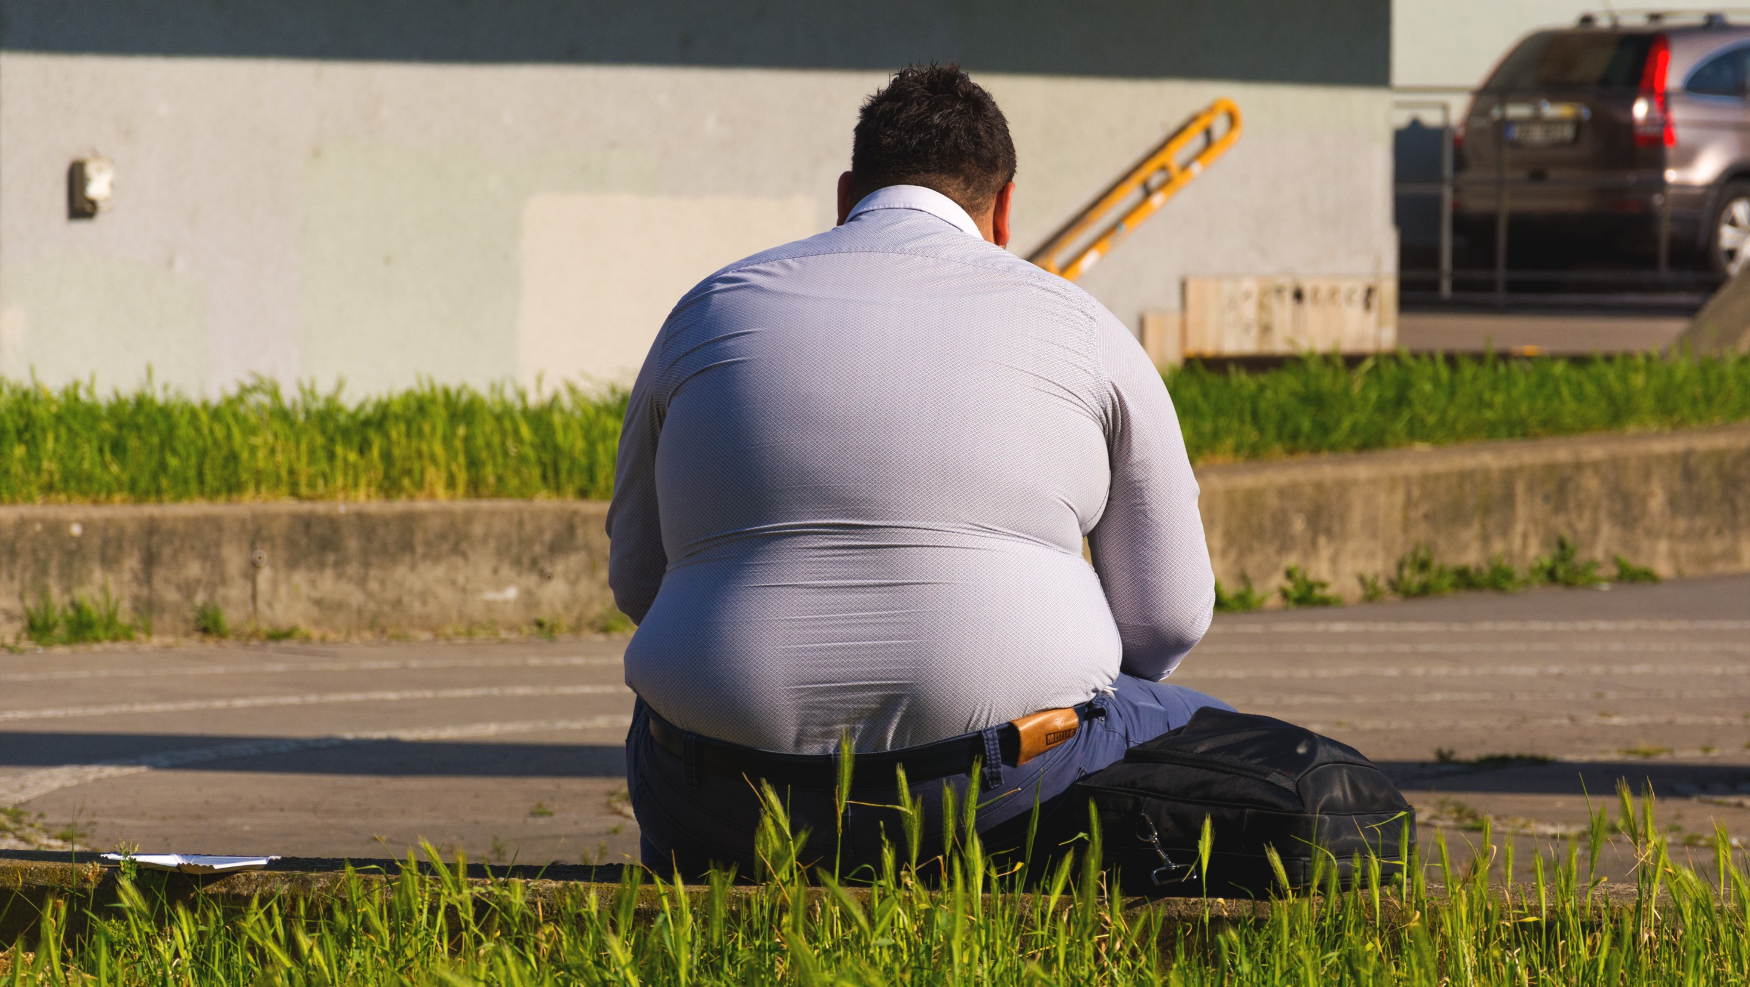

Slide 5
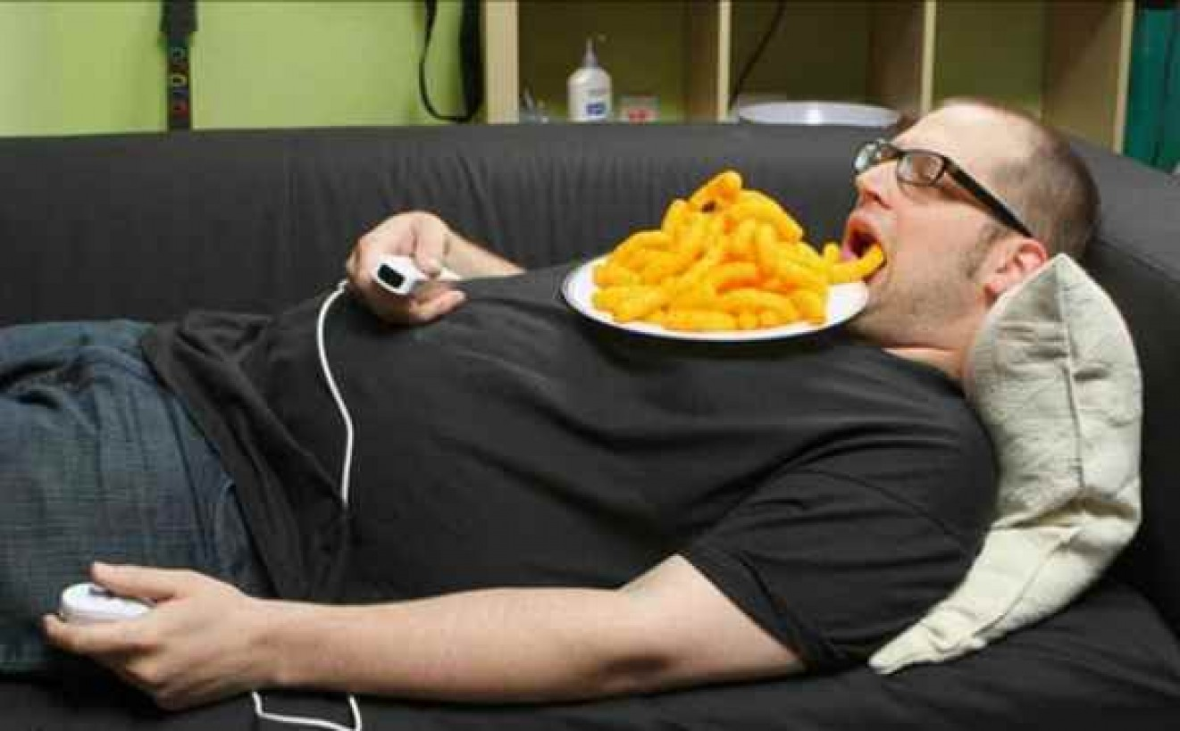

Slide 6
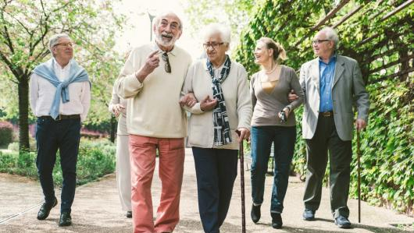

Slide 7
Health, with Space Tech
GNSS
User location
Personalized routes
Earth Observation Data
Air quality (Sentinel 5P)
Green Spaces (Sentinel 2)
Solar Incidence (Sentinel 5P)

Slide 8

Our Business Model
Features |  | Free | Premium
Personalized Routes | Green Spaces
 | Air Quality | -
 | Sun Incidence | -
Weekly Health Report |  | -

Slide 9
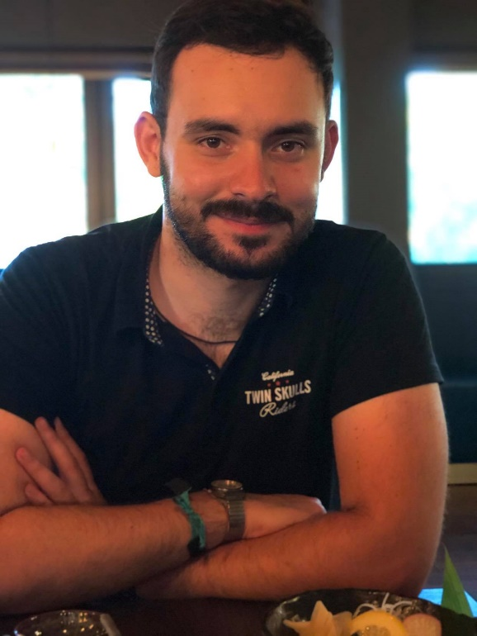
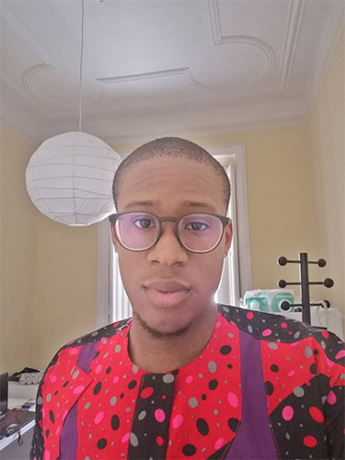
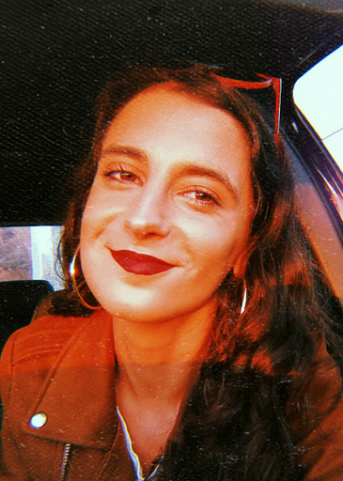
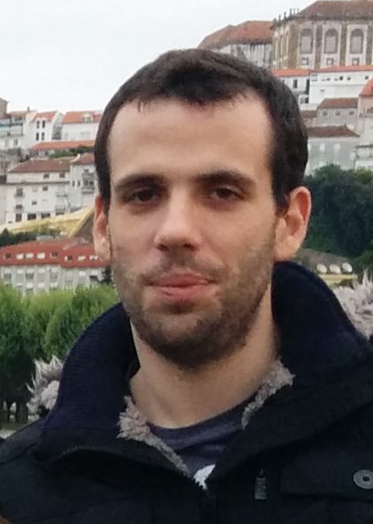
This is VIVATIV!
Pedro Tavares
Designer & Developer
Chukwuemeka Igwe
Geospatial Specialist
Inês Moreira
Business Manager
Gustavo Sousa Backend Developer
Notes:
<number>

Slide 10

Always Living. Always Active.

